Slide 2
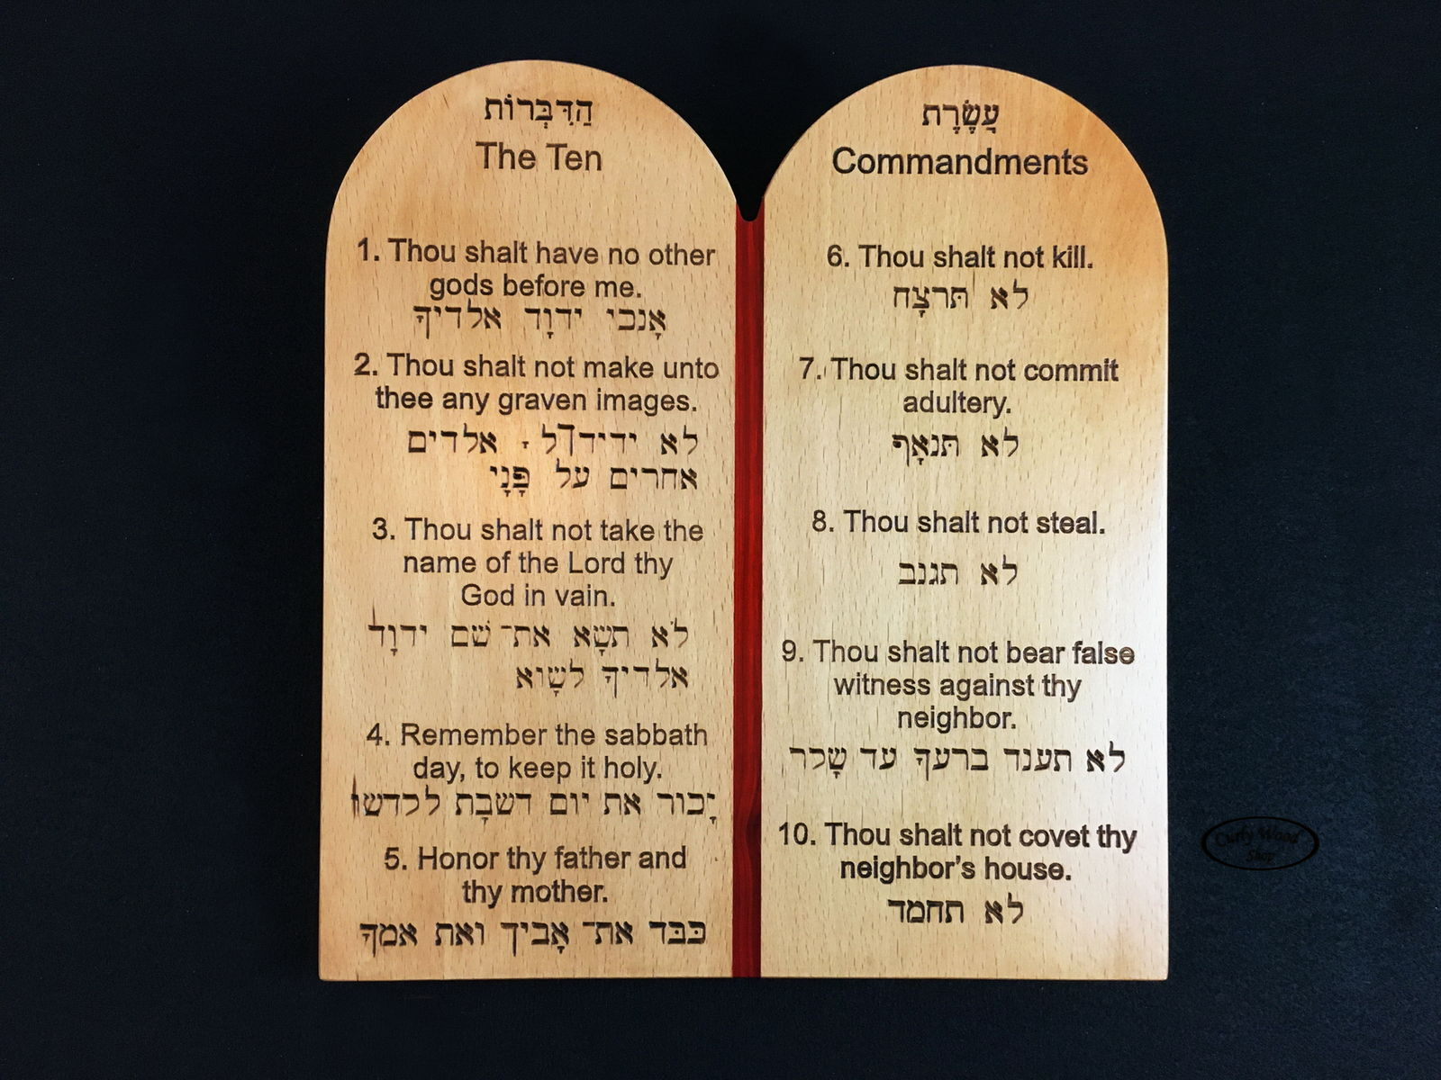
Is the sabbath binding on us today?
Deuteronomy 5:14

Slide 3
THREE DISTINCT DISPENSATIONS
God dealt through “fathers” of each family
Adam, Noah, Abraham and Isaac examples
When it was fulfilled, God called Israel out and gave another law
Gentiles continued under this law until Cornelius
PATRIARCHAL
Included Ten Commandments
Also various ordinances to live and worship by
Aaronic priesthood to serve under this law
LAW OF MOSES
Replaced both Patriarchal and Mosaical laws
High Priest now according to the order of Melchizedek
LAW OF CHRIST

Slide 4
Law which included sabbath worship taken away
Colossians 2:14 “taken it out of the way, having nailed it to the cross.”
Galatians 3:24,25 “…after faith has come, we are no longer under a tutor”
Romans 6:14 “you are not under law but under grace.”
John 1:17 “grace and truth came through Jesus Christ.”
Hebrews 7:12 “priesthood being changed…a change of the law.”
Hebrews 8:6 “He is the Mediator of a better covenant… established on better promises.”

Slide 5
Law of moses and law of god
No distinction between Ceremonial and Moral law
GOD’S LAW = LAW OF MOSES
Nehemiah 10:29 “God’s Law…given by Moses…”
Ezra 7:6 “the Law of Moses, which the Lord God…given”
Nehemiah 8:1”Law of Moses, which the LORD had commanded Israel.”
2 Chronicles 34:14 “Book of the Law of the LORD given by Moses.”
Ezra 7:7-12 “scribe of the Law of the God”
Luke 2:22-24 “law of Moses… the law of the Lord”

Slide 6
What was taken out of the way?
2 Corinthians 3:7-11 “written and engraved on stones… what is passing away was glorious, what remains is much more glorious."
WHEN WAS THE SABBATH TAKEN AWAY?
Deuteronomy 5:3 “did not make this covenant with our fathers, but with us, those who are here today…”
The COVENANT which included the SABBATH was given to the JEWS!
Nehemiah 9:13,14 “made known to them Your holy Sabbath…By the hand of Moses Your servant."

Slide 7
What was taken out of the way?
Deuteronomy 5:14,15 “the seventh day is the Sabbath of the LORD your God..”
Exodus 31:13-17 “Speak also to the children of Israel, saying: 'Surely My Sabbaths you shall keep, for it is a sign between Me… observe the Sabbath throughout their generations as a perpetual covenant.”
A perpetual sign between GOD and ISRAEL!
NOT ALL MEN OF EVERY AGE!
When God gave up Israel as His people, there was no longer a command for people to remember the Sabbath

Slide 8
A new day for worship – first day
Mark 16:9 “He rose early on the first day of the week”
Acts 2:1 “When the Day of Pentecost had fully come”
Acts 20:7 “ on the first day of the week, when the disciples came together to break bread”
1 Corinthians 16:1,2 “2 On the first day of the week let each one of you lay something aside”
No other day is specified for the Lord’s Supper or our giving
TWO acts of worship peculiar to the Law of Christ

Slide 9
The new testament of christ’s church
  NOWHERE COMMANDS ANYONE TO REMEMBER THE SABBATH – NO ONE EVER CORRECTED FOR NOT KEEPING IT
  Galatians 5:4 “estranged from Christ, you who attempt to be justified by law; you have fallen from grace."
  Galatians 4:9-11 “You observe days and months and seasons and years. 11 I am afraid for you, lest I have labored for you in vain."
  1 Corinthians 16:1,2 “2 On the first day of the week let each one of you lay something aside”

Slide 10
Few if any keep the sabbath today
  Commanded to do NO WORK – Deuteronomy 5:12-15
  Not even to build a FIRE – Exodus 35:3
  Could buy NO FOOD – Nehemiah 10:31
  Could no CARRY ANYTHING – Nehemiah 13:15-18
  Could only travel a FRACTION OF A MILE – Exodus 16:28-39; Numbers 35:5
  City gates where CLOSED – Nehemiah 13:9
  Worshipped according to LAW OF MOSES- Acts 15:21
  Put people who BROKE IT TO DEATH – Exodus 31:14,15

